Slide 1
Subsidizing Health Insurance for Low-Income Adults:
Evidence from Massachusetts
Amy Finkelstein
MIT and NBER
Nathaniel Hendren
Harvard University and NBER
Mark Shepard
Harvard Kennedy School and NBER
November 2017

Slide 2
Motivation
How much are low-income people willing to pay (WTP) for health insurance? What are the implications for insurance markets?
Health insurance is by far the largest means-tested transfer in US
  In 2015: $550 billion on Medicaid vs. $70b or less on next biggest programs (food stamps, EITC, SSI, TANF)
  Key question: How much are recipients WTP for in-kind insurance?
  Little prior evidence – until recently a non-traded good
Health care reforms: Increasingly try to cover low-income uninsured via partially subsidized insurance
  ACA exchanges, state Medicaid reforms requiring premiums
  Will partial subsidies get to universal coverage? Depends on WTP
Notes:
Overall outline:
Simple question
Two reasons that this q matters: (1) Understanding value of largest means-tested transfer,
(2) Testing assumption of health reform (ACA) – will partial subsidies get to universal covg?

Slide 3
Overview of This Paper
Evidence from setting where can measure revealed preference WTP (demand) and cost of health insurance for low-income population
Setting: Subsidized exchange in Massachusetts (pre-ACA)
  Model for ACA: Similar design, low-income population choosing b/n heavily subsidized coverage vs. uninsurance
  Key feature: Subsidies vary by discrete income bin → RD price variation
    E.g., 149% poverty person has $0 plan; 151% poverty pays $39/month
Method: Use price variation to estimate WTP, cost of insurance
  Descriptive: How do lower subsidies affect take-up, average cost of enrollees in insurance market?
  Use simple model to map observed take-up, cost → WTP, cost curves

Slide 4
Summary of Results
Descriptive findings:
  Insurance demand is highly price sensitive
  Adverse selection (despite coverage mandate)
    Enrollee premium ↑ by $40 per month → Take-up falls 25%,
    Average cost of enrollees higher by $10-50 (= 3-14%)
Implications of WTP, Cost Curve Estimates:
  Modest premiums are major deterrent to universal coverage
    E.g., subsidies covering 75% of insurer costs still leave >50% uninsured
  Adverse selection exists but is not primary driver of low take-up
    WTP is far below not just average costs, but also marginal enrollees’ costs imposed on insurer (for >70% of eligible pop.)
Discussion:
  Why is WTP so far below cost? And what are the normative implications?
    Key factor: Uncompensated care for uninsured (charity care, unpaid bills)

Slide 5
Outline
Setting and Descriptive Evidence
Model and Estimates of WTP, Cost Curves
Discussion and Normative Implications
Conclusion

Slide 6
1. Setting and Descriptive Evidence

Slide 7
Setting: Mass. Health Insurance Exchange
Setting: Pre-ACA subsidized insurance exchange (CommCare)
  Introduced in 2006 “Romneycare” reform
  ACA-like eligible population: Low-income adults (<300% poverty) w/out access to employer insurance or other public insurance
    Relevant choice: CommCare plan vs. Uninsurance
  Focus on 135-300% poverty and simple market setting in 2011
    Also show descriptive results for 2009-13
Benefits standardized, set to be quite generous
  Cover >94% of costs (like “platinum” plan in ACA)
  Each insurer offers a single plan, can set networks of doctors/hospitals
Subsidies are also generous (cover >80% of insurer prices/costs)
  Set to make lowest enrollee premium “affordable” (0-5% of income)
Notes:
Start at 135% poverty b/c eligibility change at 133% poverty

Slide 8
Subsidy and Premium Discontinuities (2011)
400
Insurer Price
300
Public
Subsidies
$ per month
200
$116
100
$77
“Affordable Amt.”
(cheapest plan)
$39
Enrollee
Premium
0
$0
135
150
200
250
300
Income, % of Poverty
Notes:
Use this slide to explain the institutions of applying for CommCare and what the premiums are, specifically:
Insurers participate in CommCare and bid a price (dashed line). This graph shows 2011 – price is same across incomes – and the cheapest plan
Beneficiaries apply for program and if eligible, based on their income, end up owing the enrollee premiums shown in solid green for the cheapest plan. These are set by the state to be “affordable amounts” (0-5% of income)
Don’t go into details about application process but be ready to answer questions.
State covers the rest of the price via a public subsidy → Click and roll this out
Notice that the enrollee premium (as set by the state) jumps discontinuously at 150%, 200%, 250% FPL → This motivates our RD strategy, as we’ll formalize in a few slides.

Slide 9
Subsidy and Premium Discontinuities (2011)
400
Insurer Price
300
Public
Subsidies
$ per month
Four Other Plans
200
~$147
~$106
$116
100
~$58
$77
Cheapest plan
Enrollee
Premium
~$11
$39
0
$0
135
150
200
250
300
Income, % of Poverty
Notes:
[GO QUICKLY HERE]
Now we add on the remaining insurers’ prices and premiums for higher-price insurers. These charge a higher price and thus, enrollees pay higher enrollee premiums.
Note that premiums for all plans jump at the same income discontinuities.
Foreshadowing H/L: Notice that four other plans have very similar prices and premiums – all priced w/in $3 of a binding price cap.

Slide 10
Data and Sample Construction
Plan enrollment (CommCare admin data)
  Start with individual-level data
  Collapse to plan enrollment by income (% of FPL)
Insurer medical costs (CommCare claims data)
  Linked to enrollment; Collapse to average cost by income (% of FPL)
Eligible population size (American Community Survey)
  Restrict to CommCare-eligible people based on observables
  (age, income, insurance status, citizenship)
  Estimate smoothed eligible population size using this sample’s
  avg. insurance take-up rate (63%) and income distribution
    Do robustness checks on these assumptions
→ Graph
Notes:
If use comm care counts / ACS denominator get 37% take up which we think is too low given estimates from MA hi survey and tax filing data.

Slide 11
RD Analysis and Assumption
RD Analysis: Use premium change at income thresholds to test for:
  Demand response: Does enrollment fall?
  Adverse Selection: Do average costs of enrolled population increase
  (suggesting healthy differentially leave)?
Key assumption: No strategic income manipulation around cutoffs
  I.e., Eligible population is smooth through cutoffs → so any enrollment change is driven by demand response
No evidence of strategic manipulation
  Institutional: Mapping from reported info to income measure used for subsidies (income as % of FPL) is not salient to applicants
  No bunching in income distribution of eligible pop. in ACS (→ Graphs)
  No spikes/holes in enrollment distribution around cutoffs in 2011
Notes:
XX nathan: I edited point #1 on strategic manipulation. The key is that individuals are not told/shown. Mention when discussing point #1: Individuals only learn of their premiums after submitting their income – it’s not like it’s a real-time updating thing that they can just see how their incomes affects their premiums.

Slide 12
Enrollment Counts, by Income (2011)
5000
RD = -1054
(318)
4000
%Δ = -26%
RD = -641
3000
(157)
%Δ = -27%
RD = -326
2000
(99)
%Δ = -25%
1000
0
135
150
200
250
300
Income, % of Poverty

Slide 13
Raw Data: Enrollment and Eligible Population (2011)
4500
(Smoothed) Estimate of Eligible Population Size
3000
1500
Raw Count of CommCare Enrollment
0
135
150
200
250
300
Income, % of Poverty
Notes:
Make sure to note here that we looked hard but didn’t see any evidence of strategic manipulation – thus, we are assuming a smooth eligible population through cutoffs.

Slide 14
Share of Eligible Population Insured
1
94%
76%
.8
58%
.6
70%
.4
56%
RD = -0.24
(0.07)
RD = -0.20
44%
%Δ = -26%
(0.05)
.2
RD = -0.14
%Δ = -27%
(0.04)
%Δ = -24%
0
P_{min}=$0
P_{min} = $39
P_{min} = $77
P_{min} = $116
135
150
200
250
300
Income, % of FPL

Slide 15
Average Insurer Costs, by Income (2009-2013)
420
RD = 47.3
RD = 32.4
RD = 6.2
(7.7)
(8.7)
(11.9)
%Δ = +15%
%Δ = +9%
%Δ = +2%
380
$ / month
340
300
133
150
200
250
300
Income, % of Poverty
→ Additional Evidence: Age and Risk Score RDs

Slide 16
Average Insurer Costs, by Income (2011)
420
RD = 46.9
RD = 30.9
RD = 14.7
(15.8)
(17.7)
(21.7)
%Δ = +14%
%Δ = +9%
%Δ = +4%
380
$ / month
340
300
133
150
200
250
300
Income, % of Poverty
Notes:
Do this very quickly – just note that 2011 is noisier than pooled graph, but the point estimates are about the same size.

Slide 17
Summary of Descriptive Evidence
Low-income insurance demand is highly price sensitive
  Falls ~25% for each ~$40 increase in cheapest enrollee premium
  Modest premiums are a major deterrent to coverage for low-income population
Cost RDs: Evidence of adverse selection
  Average cost rises by 2-15% ($6-50 / month) as covg. falls at RDs
  Enrollees who leave are lower cost than remaining people
How to translate into WTP/cost curves? Need a model (next step)
Notes:
Maybe just skip this slide (but keep in deck in case seems helpful)
But skip if low on time.

Slide 18
2. Model and Estimates of WTP, Cost Curves

Slide 19
Translating Evidence into WTP, Cost Curves
Goal: Use this evidence to measure implied WTP, cost curves
Starting point: Einav, Finkelstein, Cullen (2010) framework
  Uses exogenous price variation to estimate (and graph) insurance demand and cost curves
  Extend framework to allow >2 options that are vertically ranked
Focus on 2011 where market has useful vertical structure
  Four plans with broader networks set price w/in $3 of binding cap ($426)
  One limited-network plan (CeltiCare) set lower price ($405)
  Grouping: “L plan” (CeltiCare), “H plan” (all others), “U” (uninsured)
Vertical model assumptions:
  Vertical preferences: Everyone prefers H > L
  Single index (s) of WTP heterogeneity (= “WTP for generosity”)

Slide 20
Vertical Model and Identification
WTP
Identification:
Variation in P_{L} + Observed Share(H+L) → Identifies W_{L}(s)
W_{H}
P_{H} – P_{L}
Variation in P_{H} – P_{L} + Observed Share(H) → Identifies ΔW_{HL}(s)
ΔW_{HL}
Calculate W_{H}(s) = W_{L}(s) + ΔW_{HL}(s)
W_{L}
P_{L}
Buy H
Buy L
Buy U
s
s*_{HL}
s*_{LU}

Slide 21
Observed Demand Points (Share_{H+L}, P_{L})
125
(0.44, $116)
100
250% FPL
75
(0.58, $77)
(0.56, $77)
$/month
200% FPL
50
(0.76, $39)
(0.70, $39)
25
150% FPL
0
(0.94, $0)
.2
.4
.6
.8
1
Share with Formal Insurance
Notes:
Run through the next 7 slides pretty quickly but just here to show how can construct WTP curves from the data…

Slide 22
WTP for L Plan (W_{L}(s))
125
(0.44, $116)
100
W_{L}^{250% FPL}
75
(0.58, $77)
(0.56, $77)
$/month
W_{L}^{200% FPL}
50
(0.76, $39)
(0.70, $39)
25
W_{L}^{150% FPL}
0
(0.94, $0)
.2
.4
.6
.8
1
s

Slide 23
WTP for L Plan (W_{L}(s)): Income Adjustment
125
(0.36, $116)
Assumption
W_{L}(s,y) = W_{L}(s + λ_{y}, 150%)
W_{L}^{250% FPL}
100
75
(0.50, $77)
$/month
W_{L}^{200% FPL}
50
Adjusted W_{L}
(150% FPL)
(0.70, $39)
25
W_{L}^{150% FPL}
0
(0.94, $0)
.2
.4
.6
.8
1
s

Slide 24
Observed Demand Points (Share_{H}, P_{H} – P_{L})
40
250% FPL
(0.39, $31)
30
(0.52, $29)
(0.50, $29)
200% FPL
$/month
20
(0.70, $19)
(0.64, $19)
150% FPL
10
(0.80, $11)
0
.2
.4
.6
.8
1
Share Purchasing H Plan

Slide 25
WTP for H relative to L (ΔW_{HL}(s))
40
ΔW_{HL}^{250% FPL}
(0.39, $31)
30
(0.52, $29)
(0.50, $29)
ΔW_{HL}^{200% FPL}
$/month
20
(0.70, $19)
(0.64, $19)
ΔW_{HL}^{150% FPL}
10
(0.80, $11)
0
.2
.4
.6
.8
1
s

Slide 26
WTP for H relative to L (ΔW_{HL}(s)) – Adjusted
40
Assumption
ΔW_{HL}(s,y) = ΔW_{HL}(s + λ_{y}, 150%)
(0.31, $31)
ΔW_{HL}^{250% FPL}
30
(0.44, $29)
ΔW_{HL}^{200% FPL}
$/month
20
(0.64, $19)
Adjusted ΔW_{HL}
(150% FPL)
ΔW_{HL}^{150% FPL}
10
(0.80, $11)
0
.2
.4
.6
.8
1
s

Slide 27
Final WTP Curves for Insurance
160
W_{H}(s)
120
ΔW_{HL}(s)
(0.36, $116)
$ per month
80
(0.50, $77)
40
(0.70, $39)
W_{L}(s)
0
(0.94, $0)
0
.2
.4
.6
.8
1
s

Slide 28
Estimating Cost of Marginal Consumers
Efficiency in insurance markets depends on comparison b/n WTP (just estimated) vs. cost of marginal consumers
  Adverse selection: Marginal consumers are lower-cost than average
Cost curve notation:
  C_{j}(s) = Insurer cost (in plan j) for consumer of type s
  = Cost of marginal enrollees if P_{j} = W_{j}(s) (in market with only plan j)
  AC_{j}(s) = Insurer’s average cost if cover all types with WTP ≥ W_{j}(s)
Use effect of price variation on AC_{H} to estimate C_{H}(s)
  Analogous to Einav, Finkelstein, Cullen (2010)
  Focus on C_{H} but have alternate method for estimating C_{L}(s) (→ Details)

Slide 29
Identifying Cost of H Plan
Cost
C_{H}(s)
Observed Avg. Cost of H
= AC_{H}(s*_{HL})
s
0
Buy H
Buy L
Uninsured
1
s*_{HL}

Slide 30
Identifying Cost of H Plan: Using Price Variation
Cost
C_{H}(s)
Observed Avg. Cost (P_{H}²)
Observed Avg. Cost (P_{H}¹)
Infer C_{H}(s)
Premium
Increase
s
0
Buy H
1
s*_{HL}(P²)
s*_{HL}(P¹)

Slide 31
Observed Average Costs (H Plan)
150% FPL
400
Average
200% FPL
Cost (H)
300
250% FPL
$ per month
200
100
0
→ H and L Plan Cost RDs
.2
.3
.4
.5
.6
.7
.8
.9
1
Fraction in H Plan
Notes:
AC with MC points

Slide 32
Adjusted Average Cost Curve (H Plan)
150% FPL Adjustment
400
Average
200% FPL
Cost (H)
300
250% FPL
$ per month
200
100
0
.2
.3
.4
.5
.6
.7
.8
.9
1
Fraction in H Plan
Notes:
AC with MC points

Slide 33
Final WTP and Cost Curves
400
AC_{H}(s)
300
C_{H}(s)
(=Cost of Marginal
Enrollees)
$ per month
200
W_{H}(s)
100
W_{L}(s)
0
.2
.3
.4
.5
.6
.7
.8
.9
1
s

Slide 34
Result #1: Substantial Adverse Selection
400
AC_{H}(s)
300
Downward sloping cost curves
C_{H}(s)
$ per month
200
W_{H}(s)
100
0
.2
.3
.4
.5
.6
.7
.8
.9
1
s
Notes:
Adjusted MC and AC with WTP_H

Slide 35
Result #2: Little Take-up w/out Large Subsidies
400
AC_{H}(s)
300
C_{H}(s)
$ per month
200
W_{H}(s)
Demand well below average cost
Premium = 25% of AC → 49% take-up
Premium = 10% of AC → 79% take-up
100
0
.2
.3
.4
.5
.6
.7
.8
.9
1
s

Slide 36
Result #3: Adverse selection alone cannot explain low coverage
400
AC_{H}(s)
300
C_{H}(s)
$ per month
200
W_{H}(s)
Demand also well below enrollees’ own expected costs
100
0
.2
.3
.4
.5
.6
.7
.8
.9
1
s
Notes:
Adjusted MC and AC with WTP_H

Slide 37
Robustness
Main result: Low-income WTP for insurance is far below own expected medical costs (for entire 70% of eligible pop. we observe)
  Also Adverse selection: Marginal enrollee costs < Average costs
Robust to a variety of econometric, modeling choices (→ Table)
Alternate RD specifications
Alternate take-up estimates from ACS
Accounting for mandate penalty (using “normalized” premiums)
Low WTP not driven by inertia (→ New enrollee RDs)
Low WTP robust to relaxing vertical model (→ Bounds method)

Slide 38
3. Discussion and Normative Implications

Slide 39
Discussion
Two key questions:
  Why is willingness to pay lower than individual’s own costs?
  What are the normative implications?

Slide 40
Why is WTP Below Own Costs?
Behavioral biases (inattention, inertia, information, misperception…)
  Similar demand responsiveness for new enrollees argues against inattention / inertia as explanations
  But cannot rule out behavioral biases more broadly
Moral hazard – textbook reason for WTP < Cost
  But required magnitude not plausible
  Moral hazard would have to increase costs by ~200% to explain gap between WTP and Costs
  Oregon experiment moral hazard estimate: 25%
Uncompensated care (charity care, unpaid bills)
  Important: Low-income uninsured pay just ~20% of their medical costs out of pocket (Finkelstein, Hendren, Luttmer 2015)
  Use this + moral hazard estimate to construct “Net Cost Curve”
  = Cost to insurer – Savings to third parties on uncompensated care

Slide 41
WTP and Cost Curves, Adjusted for Uncomp. Care
400
AC_{H}(s)
300
Uncompensated Care Estimate
$ per month
C_{H}(s)
200
100
“Net Cost”
= C_{H}(s)-C_{U}(s)
W_{H}(s)
0
.2
.3
.4
.5
.6
.7
.8
.9
1
Fraction in H Plan (= s)

Slide 42
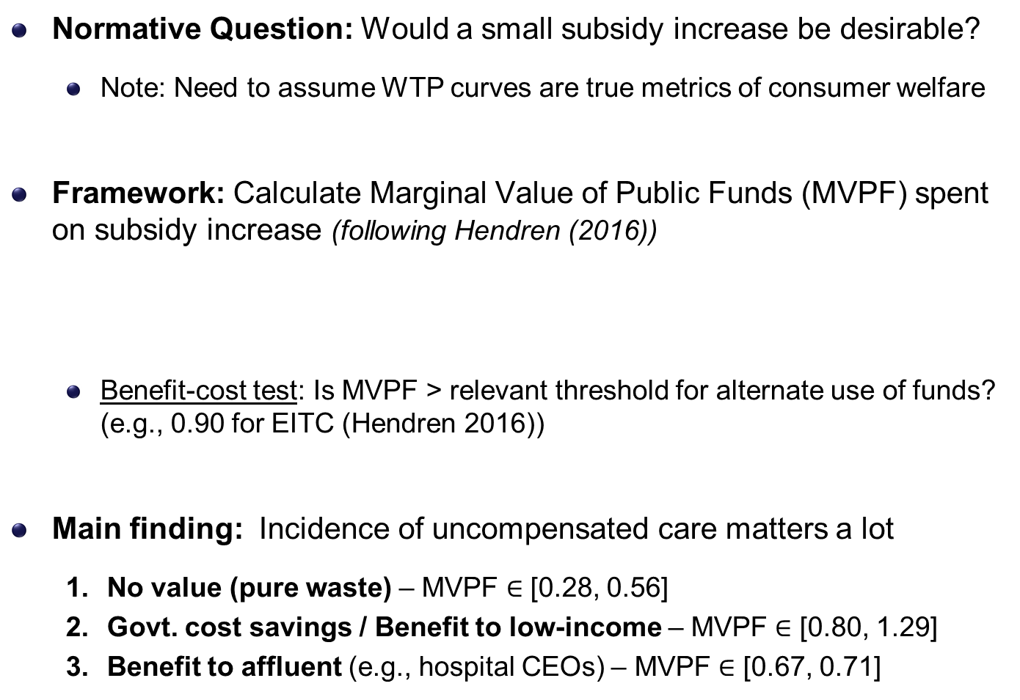
Normative Implications
Normative Question: Would a small subsidy increase be desirable?
  Note: Need to assume WTP curves are true metrics of consumer welfare
Framework: Calculate Marginal Value of Public Funds (MVPF) spent on subsidy increase (following Hendren (2016))
  Benefit-cost test: Is MVPF > relevant threshold for alternate use of funds? (e.g., 0.90 for EITC (Hendren 2016))
Main finding: Incidence of uncompensated care matters a lot
  No value (pure waste) – MVPF $∈$ [0.28, 0.56]
  Govt. cost savings / Benefit to low-income – MVPF $∈$ [0.80, 1.29]
  Benefit to affluent (e.g., hospital CEOs) – MVPF $∈$ [0.67, 0.71]

Slide 43
Conclusion
Exploit discontinuities in premiums in Massachusetts to estimate WTP and cost of insurance among low-income population
Main Finding: WTP is far below insurer costs
  Adverse selection exists but is not the key issue
  Enrollees not willing to pay own expected cost of coverage
    Uncompensated care provides a potential explanation
Implications for economics of subsidizing health insurance
  Partial subsidies unlikely to get close to universal coverage
  Enrollees themselves may not be primary beneficiaries of subsidies
Important topic for further work: Incidence and efficiency of uncompensated care vs. formal subsidized insurance

Slide 44
Thank You!

Slide 45
Appendix Slides

Slide 46
Estimate of Eligible Population from ACS (2011)
15000
10000
5000
0
135
150
200
250
300
Income (% of Poverty)
5% FPL bins
Regression Smoothed
← Go back

Slide 47
Estimate of Eligible Population from ACS (2009-2013)
15000
10000
5000
0
135
150
200
250
300
← Go back
Income (% of Poverty)

Slide 48
Estimate of Eligible Population from ACS (2011)
15000
10000
5000
0
135
150
200
250
300
Income (% of Poverty)
5% FPL bins
Regression Smoothed
← Go back

Slide 49
Average Age of Enrollees (2009-2013)
47
46
45
RD = 0.61
(0.25)
44
RD = 0.56
(0.21)
43
RD = 1.71
(0.20)
42
133
150
200
250
300
Income, % of FPL

Slide 50
Average Risk Score of Enrollees (2009-2013)
1.1
1.05
RD = 0.063
RD = 0.057
RD = 0.022
(0.009)
(0.011)
(0.013)
1
133
150
200
250
300
Income, % of FPL
← Go back

Slide 51
RD for Average Insurer Costs: H Plans, 2011
420
380
$ per month
340
RD = 32.3
RD = 34.5
RD = 19.6
(16.7)
(18.8)
(24.1)
300
%Δ = +9%
%Δ = +9%
%Δ = +6%
133
150
200
250
300
← Go back
Income, % of Poverty

Slide 52
RD for Average Insurer Costs: L Plan, 2011
300
250
200
$ per month
150
100
RD = 72.9
RD = 54.9
RD = -22.3
(35.0)
(25.8)
(27.1)
50
%Δ = +43%
%Δ = +32%
%Δ = -13%
133
150
200
250
300
← Go back
Income, % of Poverty

Slide 53
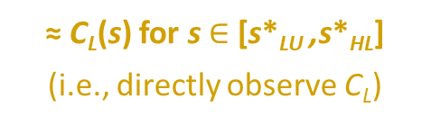
Identifying Cost Curves: L Plan
Cost
C_{H}(s)
Observed Avg. Cost of L
≈ C_{L}(s) for s $∈$ [s*_{LU} ,s*_{HL}]
(i.e., directly observe C_{L})
C_{L}(s)
s
0
Buy H
Buy L
Uninsured
1
← Go back
s*_{HL}
s*_{LU}

Slide 54
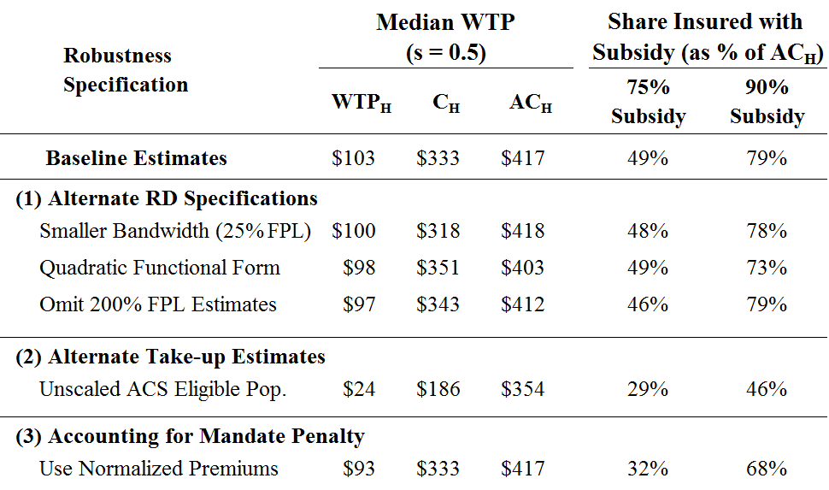
Sensitivity Analysis: WTP, Cost, and Take-Up Estimates
← Go back

Slide 55
Enrollment in All Plans, Limited to New Enrollees, 2011
1250
RD = -224.6
(57.4)
1000
%Δ = -28%
RD = -120.2
750
(26.8)
%Δ = -28%
RD = -53.4
(18.4)
500
%Δ = -22%
250
0
135
150
200
250
300
Income, % of FPL
← Go back

Slide 56
Enrollment in H Plan, Limited to New Enrollees, 2011
1250
RD = -164.0
1000
(50.6)
%Δ = -25%
750
RD = -124.1
(22.1)
%Δ = -33%
500
RD = -44.7
(15.2)
%Δ = -22%
250
0
135
150
200
250
300
Income, % of FPL
← Go back

Slide 57
Bounds on WTP for CommCare Insurance
150
125
100
$ per month
75
50
25
0
.2
.4
.6
.8
1
1-s
W_L curve
W_H curve
WTP lower bound
WTP upper bound
← Go back

