Slide 1
Do Ordeals Work for Selection Markets?
Evidence from Health Insurance Auto-Enrollment
Mark Shepard Myles Wagner
Harvard Kennedy School Harvard (post-doc)
and NBER Ohio State University
Spring 2024

Slide 2
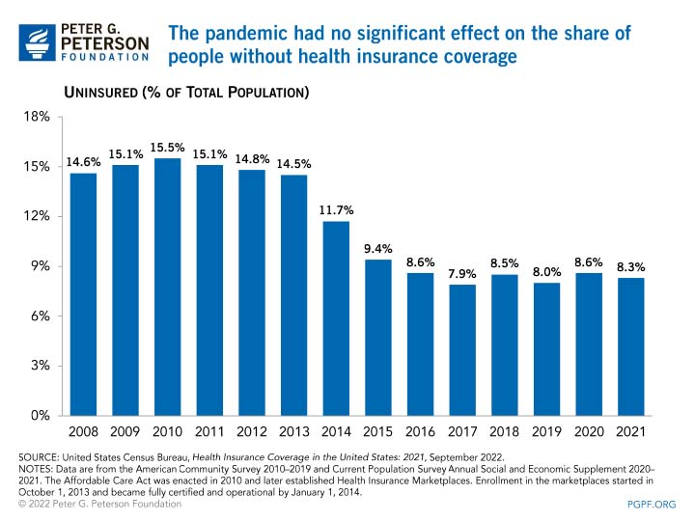

Motivation #1: Persistent Uninsurance
Universal health insurance coverage is a major goal
Despite large ACA subsidies, uninsurance remains high
  28 million uninsured in 2022
  Most uninsured (63%) are already subsidy eligible, almost half (46%) likely qualify for free coverage
  [KFF 2021]
Uninsured Rate (% of total pop.)
ACA implemented
Source: Peterson Foundation (2022)
Broader puzzle: Incomplete take-up of social programs
  E.g., EITC (78%); SNAP (82%); Pell Grants (78%), TANF (25%)

Slide 3


Two Approaches to Expand Take-Up
Std approach: Financial Incentives
  Central policy approach of the ACA
  Large body of research shows the effectiveness, but also limits of incentives
Alternative: Simpler / Automatic Enrollment
  Enrolling involves various hassles (“admin burden”). What if it were easier or automatic?
  Growing evidence that hassles matter for many programs, but less work on health insurance.
Question #1: How important are hassle costs as barrier to health insurance coverage?

Slide 4
Motivation #2: Economics of Ordeals
Is it optimal to remove enrollment hassles and ordeals?
Classic debate: Do ordeals improve targeting of public programs? [Nichols & Zeckhauser 1982]
  Active empirical debate. Some work finds improvements [Alatas et al. 2016, Dupas et al 2016, Finkelstein & Notowidigdo 2019], Others find worsening [Bhargava & Manoli 2015; Deshpande & Li 2019; Homonoff & Somerville 2021]
Standard idea: Ordeals work well when “self-screen” out people who do not obtain much benefit/value from the program
  Follows from logic of revealed preferences
  But this ignores role of varying cost → Central feature of insurance and other “selection markets” (Einav, Finkelstein & Mahoney, 2021)
Question #2: Does ordeals targeting work well in selection markets?
Notes:
EITC source: https://www.eitc.irs.gov/eitc-central/participation-rate/eitc-participation-rate-by-states
SNAP source: https://fns-prod.azureedge.net/sites/default/files/resource-files/Reaching2017-1.pdf
TANF: https://www.urban.org/sites/default/files/publication/100521/what_was_the_tanf_participation_rate_in_2016_0.pdf
Pell grants: CA research by Martorell and Friedman (https://education.ucdavis.edu/sites/main/files/ucdavis_wheelhouse_research_brief_vol3no3_online.pdf), overall stats on U.S. (https://www.brookings.edu/research/the-pell-grant-proxy-a-ubiquitous-but-flawed-measure-of-low-income-student-enrollment/)

Slide 5
Overview of Paper
Study hassle-reducing auto-enrollment policy in Massachusetts health insurance exchange (pre-ACA)
  Applies to uninsured low-income group who qualifies for free insurance
  Removes a small hassle: Choosing a health plan (passive individuals are auto-assigned by the state)
Causal evidence: Suspension of auto enrollment in 2010
  Measure impact of adding a small ordeal (active plan choice)
  DD strategy: Compare outcomes for lowest-income group (subject to auto-enrollment pre-2010) vs. higher-income controls (no auto-enr.)
Estimate model to evaluate ordeals targeting logic
  Build intuition with simple graphical model. Then estimate full empirical model of value, cost, externalities

Slide 6
Summary of Results
Take-up: Minor ordeals have a major enrollment impact
  ↓33% in enrollment when add small hassle (suspend auto-enr).
  Take-away: Removing ordeals may be key to universal coverage
Targeting: Ordeals differentially exclude young, healthy, and poor
  4 years younger, 33% less likely to be chronically ill, 44% lower medical costs per month. Also lower-income and in poorer neighborhoods.
  Take-away: Ordeals matter for insurance risk pools and for equity
Conceptual: Adverse selection undermines the classic “self-targeting” logic for ordeals
  Adverse selection: Low-value types are also low-cost (+ correlation)
  “Taxes” away the gains from targeting, making ordeals work poorly.

Slide 7
Related Literature and Contributions
Health insurance coverage and take-up
  Medicaid eligibility & subsidies/penalties matter [e.g., Frean, Gruber, Sommers 2017; Chandra, Gruber, McKnight 2011; Sacks, Lurie, Heim 2020; Tebaldi 2020]
  Modest premiums reduce take-up among the poor [Finkelstein, Hendren, Shepard 2019; Dague 2014]
  Contribution: Hassles are also a major barrier → role for auto-enrollment
Take-up “nudges” for welfare programs
  Non-health programs [e.g., Bhargava & Manoli 2016; Finkelstein & Notowidigdo 2019]
  Recent health insurance experiments [Domurat et al. 2019; Ericson et al. 2020]
  Contribution: Much larger impact of auto enrollment (+30-50% pts) versus simplified enrollment (+1-3% pts) – suggests fully automatic is key
Economics of ordeals
  Active debate about whether ordeals lead to “self-screening” on value or not.
  Contribution: Analyze ordeals for selection markets, showing how classic logic breaks down (even without behavioral frictions)
Notes:
Likely skip this during Imperial talk, due to time

Slide 8
Outline
Model: When Do Ordeals Target Well?
Setting and Policy Variation
Descriptive Results: Enrollment and Targeting Impacts
Empirical Model: Welfare Analysis of Health Insurance Ordeal
Conclusion

Slide 9
Model: When Do Ordeals Target Well?

Slide 10
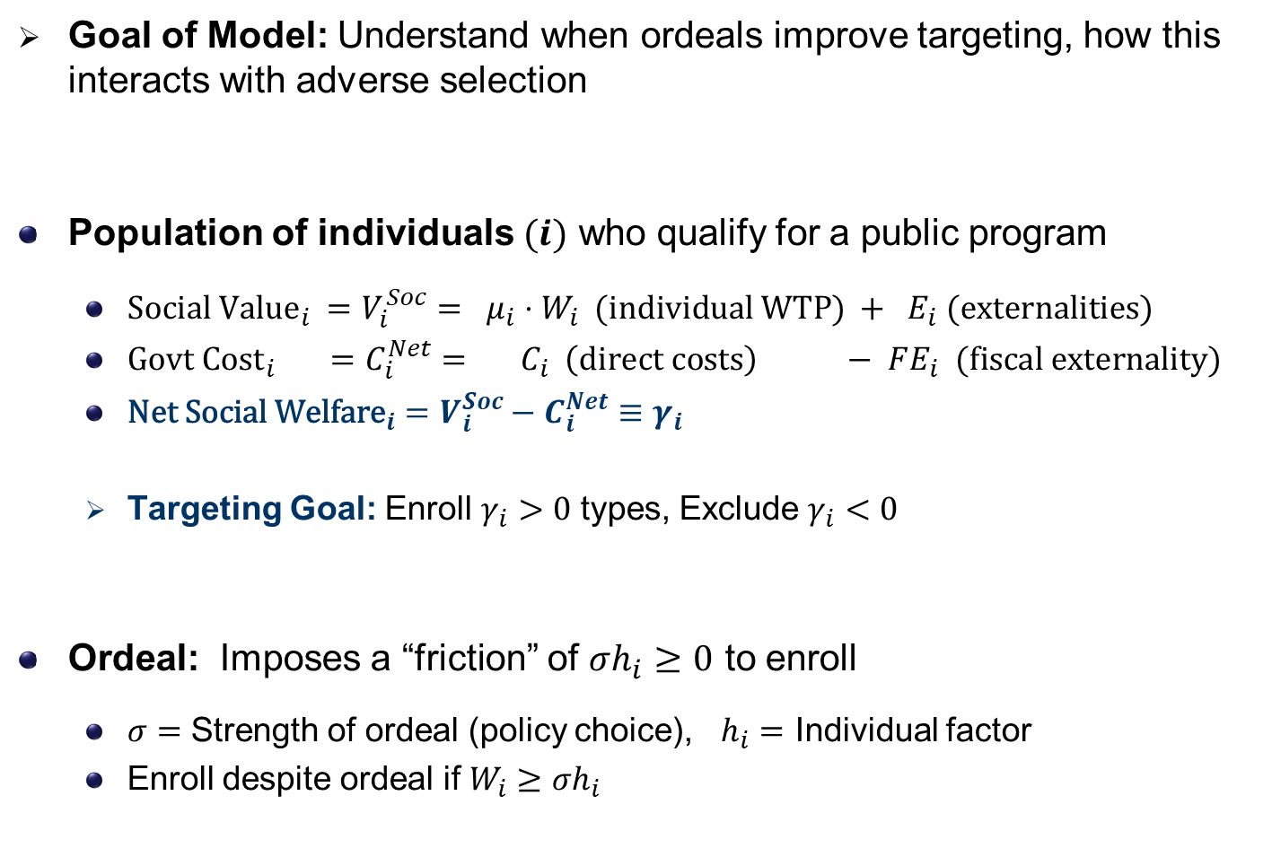
Model Setup
Goal of Model: Understand when ordeals improve targeting, how this interacts with adverse selection
Population of individuals $(i)$ who qualify for a public program
  $\text{Social} {\text{Value}}_{i} =V_{i}^{Soc}= μ_{i}⋅W_{i} \text{(}\text{individual} \text{WTP}\text{) }+ E_{i} \text{(}\text{externalities}\text{)}$
  $\text{Govt} {\text{Cost}}_{i} =C_{i}^{Net}= C_{i} \left(\text{direct} \text{costs}\right) − FE_{i} \text{(}\text{fiscal} \text{externality}\text{)}$
  $\text{Net} \text{Social} {\text{Welfare}}_{i}=V_{i}^{Soc}−C_{i}^{Net}≡γ_{i}$
  Targeting Goal: Enroll $γ_{i}>0$ types, Exclude $γ_{i}<0$
Ordeal: Imposes a “friction” of $σh_{i}≥0$ to enroll
  $σ=$ Strength of ordeal (policy choice), $h_{i}=$ Individual factor
  Enroll despite ordeal if $W_{i}≥σh_{i}$

Slide 11
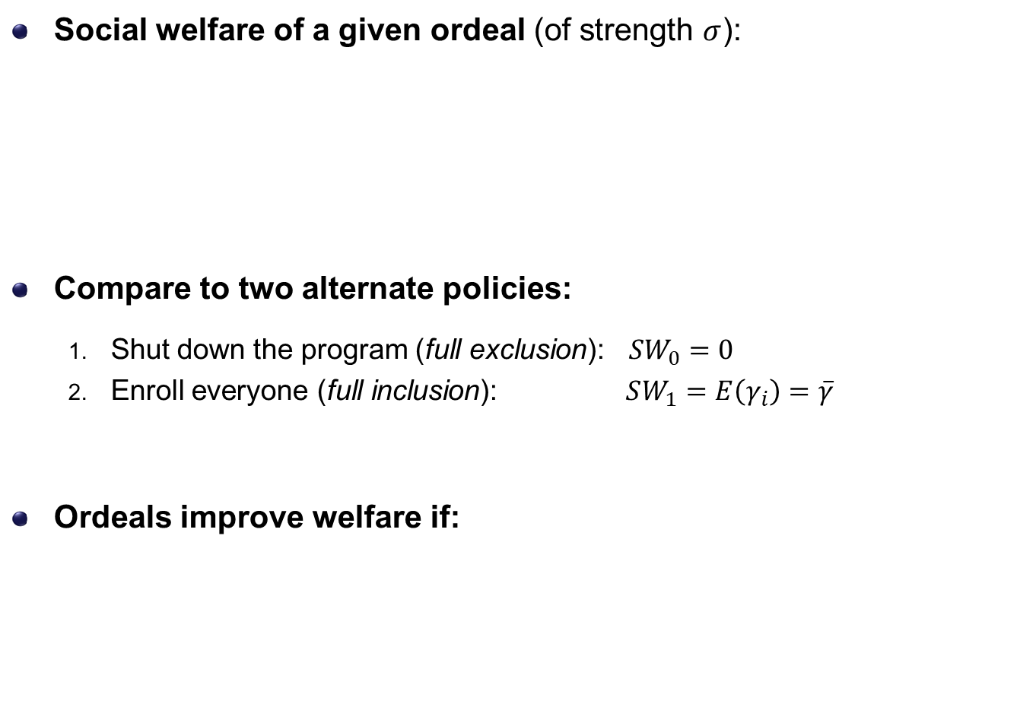
When is an Ordeal Optimal?
Social welfare of a given ordeal (of strength $σ$):
Compare to two alternate policies:
  Shut down the program (full exclusion): $SW_{0}=0$
  Enroll everyone (full inclusion): $SW_{1}=E\left(γ_{i}\right)=\overline{γ}$
Ordeals improve welfare if:

Slide 12

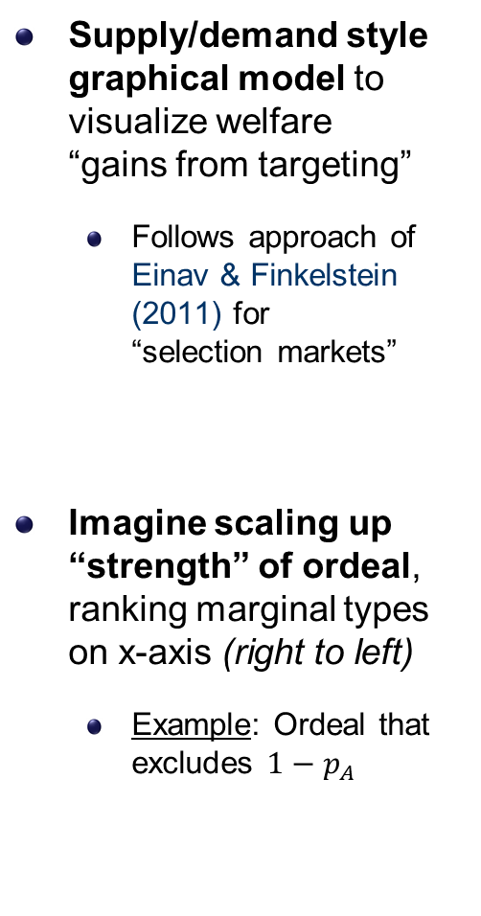

Graphical Model of Targeting Gains
Supply/demand style graphical model to visualize welfare
“gains from targeting”
  Follows approach of Einav & Finkelstein (2011) for
  “selection markets”
Imagine scaling up “strength” of ordeal,
ranking marginal types on x-axis (right to left)
  Example: Ordeal that excludes $1−p_{A}$
$$\$$$
Enrolled under A
Excluded by A
0
$$p_{A}$$
1
Share Enrolled
Stronger Ordeal

Slide 13
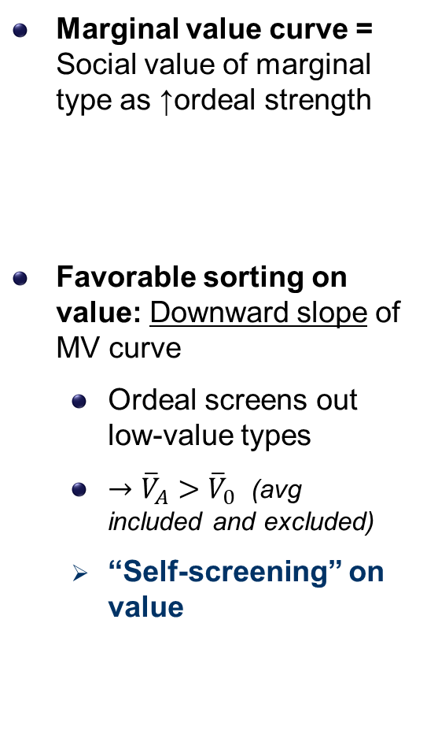


Graphical Model: Sorting on Value
Marginal value curve = Social value of marginal type as ↑ordeal strength
Favorable sorting on value: Downward slope of MV curve
  Ordeal screens out low-value types
  $→{\overline{V}}_{A}>{\overline{V}}_{0}$ (avg included and excluded)
  “Self-screening” on value
$$\$$$
Marginal Value
$${\overline{V}}_{A}$$
$${\overline{V}}_{0}$$
Enrolled under A
Excluded by A
0
$$p_{A}$$
1
Share Enrolled
Stronger Ordeal
Notes:
Include math

Slide 14
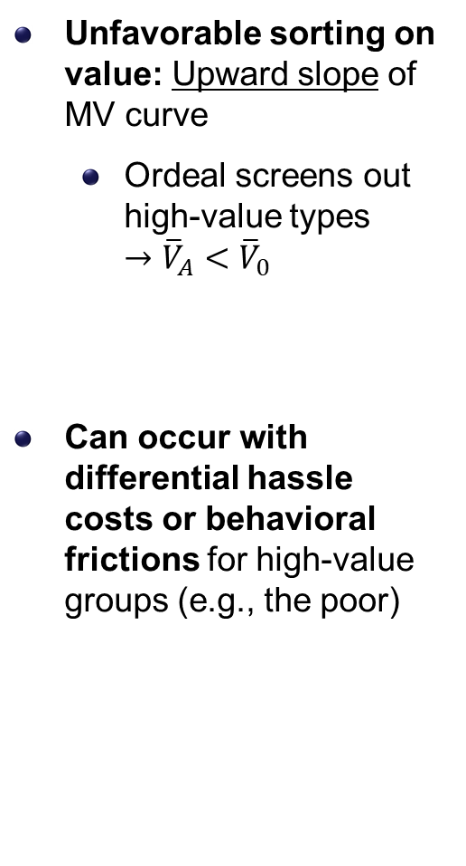


Alternate Case: Unfavorable Sorting on Value
Unfavorable sorting on value: Upward slope of MV curve
  Ordeal screens out high-value types
  $→{\overline{V}}_{A}<{\overline{V}}_{0}$
Can occur with differential hassle costs or behavioral frictions for high-value groups (e.g., the poor)
$$\$$$
Marginal Value
$${\overline{V}}_{0}$$
$${\overline{V}}_{A}$$
Enrolled under A
Excluded by A
0
$$p_{A}$$
1
Share Enrolled
Stronger Ordeal
Notes:
Include math

Slide 15
From Value Sorting to Welfare
How does value sorting relate to welfare?
Depends on cost sorting, and how value and cost are correlated
Consider two cases:
  No selection (constant / uncorr. costs)
  Adverse selection: (low-value types are also low-cost)
$$\$$$
Marginal Value
$${\overline{V}}_{A}$$
$${\overline{V}}_{0}$$
Enrolled under A
Excluded by A
0
$$p_{A}$$
1
Share Enrolled
Stronger Ordeal
Notes:
Include math

Slide 16


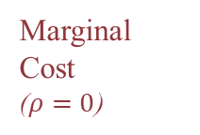


Cost Sorting: Non-Selection Market
No selection: Marginal cost curve is flat
Example: Slots in a public pre-K program
(all kids cost the same)
Gains from targeting visualized as area b/n
MV and MC
$$\$$$
Marginal Value
$${\overline{V}}_{A}$$
$${\overline{γ}}_{A}$$
$${\overline{C}}_{0}$$
Marginal Cost
($ρ=0$)
$${\overline{C}}_{A}$$
$${−\overline{γ}}_{0}$$
Gains from Targeting
$${\overline{V}}_{0}$$
Enrolled under A
Excluded by A
0
$$p_{A}$$
1
Share Enrolled
Stronger Ordeal

Slide 17

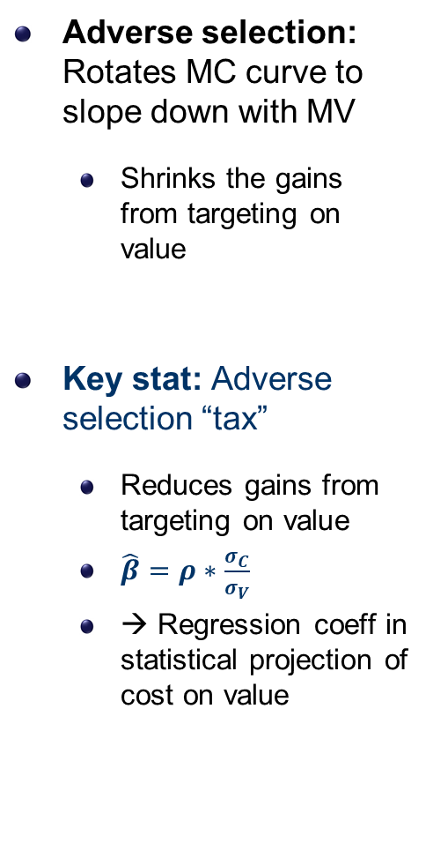



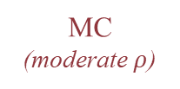

Cost Sorting: Adverse Selection (modest)
Adverse selection: Rotates MC curve to slope down with MV
  Shrinks the gains from targeting on value
Key stat: Adverse selection “tax”
  Reduces gains from targeting on value
  $\hat{β}=ρ∗\frac{σ_{C}}{σ_{V}}$
  → Regression coeff in statistical projection of cost on value
Marginal Value
$${\overline{V}}_{A}$$
MC
(moderate $ρ$)
$${\overline{C}}_{A}$$
Adverse Selection
$${\overline{C}}_{0}$$
$${\overline{V}}_{0}$$
Gains from Targeting
(smaller)
Enrolled under A
Excluded by A
0
$$p_{A}$$
1
Share Enrolled
Stronger Ordeal

Slide 18
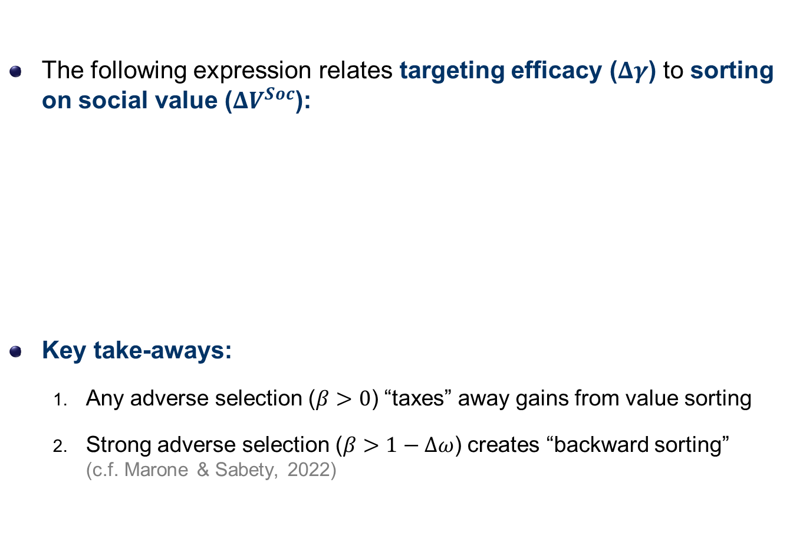
Targeting Efficacy and Adverse Selection Tax
The following expression relates targeting efficacy ($Δγ$) to sorting on social value ($ΔV^{Soc}$):
Key take-aways:
  Any adverse selection ($β>0$) “taxes” away gains from value sorting
  Strong adverse selection ($β>1−Δω$) creates “backward sorting”
  (c.f. Marone & Sabety, 2022)

Slide 19


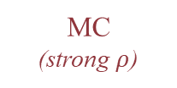
Strong Selection → Backward Sorting
“Strong” adverse selection
  MC curve is steeper than MV curve
  (i.e., ordeal sorts more on cost than value)
Implication: Ordeal gets “backward sorting”
  C.f. Marone & Sabety (AER, 2022)
MC
(strong $ρ$)
Marginal Value
$${\overline{C}}_{A}$$
$${\overline{V}}_{A}$$
Adverse Selection
$${\overline{V}}_{0}$$
$${\overline{C}}_{0}$$
Enrolled under A
Excluded by A
0
$$p_{A}$$
1
Share Enrolled
Stronger Ordeal

Slide 20
Setting and Policy Variation

Slide 21
Context: Fragmented U.S. Health Insurance
Eligible for Job-Based
Health Insurance
Eligible for Medicaid or Medicare
Medicaid + Medicare
(24%)
Job-Based
Health Insurance
(60%)
Eligibility
often changes
All Others
Individual Private Insurance
(including ACA exchanges)
(7%)
Default outcome
(if don’t actively enroll)
Uninsured
(10%)
Notes:
Show this to make sure understand take-up problem in U.S. health insurance context (fragmented!)
Emphasize the point that insurance eligibility often changes (e.g., lose job, or get job, or income changes)
Every time eligibility changes, need to *actively take up* insurance, or else become uninsured by default
Source: KFF, data for 2018 (https://www.kff.org/other/state-indicator/nonelderly-0-64)

Slide 22
Setting: Massachusetts Pre-ACA Exchange
Setting: Pre-ACA subsidized insurance exchange (“CommCare”)
  Subsidized coverage for low-income adults (< 300% of poverty) not eligible for other insurance (employer, Medicaid, Medicare, etc.)
  Relevant take-up margin: CommCare vs. Uninsurance
Plan choices: Standardized and simple
  4-5 participating insurers (one plan per insurer)
  Standardized cost sharing (with nearly 100% coverage); Networks vary.
Automatic enrollment policy:
  Applies to lowest-income group (0-100% poverty) – all plans are free
  Sets default for people who apply and qualify for coverage but fail to actively choose a plan (within 2 weeks)
    Based on similar policy used in Medicaid (but not ACA exchanges)

Slide 23
Enrollment Process and Default Policy
Need health insurance
(e.g., lost job, churn off Medicaid)
Six-page form to report income, family size, other coverage
Often assisted by social worker or medical staffer
Rejected (not eligible)
1. Eligibility Application
Approved (eligible)
Approval letter mailed to individual
Instructed to choose a plan by phone, online, or mail
2. Plan Choice
Notes:
Briefly walk through enrollment process so understand where AE applies (go fast if low on time)

Slide 24
Enrollment Process and Default Policy
Need health insurance
(e.g., lost job, churn off Medicaid)
Six-page form to report income, family size, other coverage
Often assisted by social worker or medical staffer
Rejected (not eligible)
1. Eligibility Application
Approved (eligible)
Approval letter mailed to individual
Instructed to choose a plan by phone, online, or mail
2. Plan Choice
Actively choose
a plan
Do not respond
Without auto-enrollment
Enrolled in Insurance
Auto Enrollment
Not Enrolled

Slide 25
Auto Enrollment Policy Variation
Date (state fiscal years)
2007
2010
2011
Auto enrollment in place
(0-100% poverty)
Start of exchange
Suspended
(start of 2010)
Temporarily reinstated (2010, last 3 months)
Control group: 100-200% poverty enrollees
→ No auto enrollment throughout

Slide 26
Data and Key Variables
Data: Full history of enrollment, insurance claims (at enrollee level)
  Limit sample to first-time new enrollees + their subsequent enrollment spell (different AE rules for re-enrollees) (→ Summary Stats)
  Observe flag for method of initial enrollment (active vs. auto)
  Limitation: No data on people who do not get enrolled
Analysis #1: Causal impact on enrollment
  Key vars: Count of new enrollees by date (total, active, auto)
  Also examine duration enrolled and stock of total enrollees
Analysis #2: Who are marginal enrollees due to auto enrollment?
  Key vars: Income; Demographics (age, gender, location); Medical diagnoses, utilization, and spending (from claims)

Slide 27
Results #1: Impact on Enrollment

Slide 28
New Enrollees per Month (0-100% Poverty)
7,500
Passive Enrollees
Suspension of
auto enrollment
Total
= 34% of total
in 2008-09
6,000
Temporary
reinstatement
4,500
3,000
Active
Choosers
1,500
0
2008
2009
2010
2011
2012
Fiscal Year
Points are bimonthly averages for 0-100% poverty treatment group over 2008-2012. (→ All years)

Slide 29
DD Estimates: Large Decline in New Enrollment
New Enrollees per Month (normalized: pre-period mean = 1.0)
1.2
100-200% poverty (control)
1
.8
<100% poverty (treatment)
.6
.4
Suspension of auto enrollment
DD = -0.326 **
(0.034)
.2
0
2009
2010
2011
2012
Fiscal Year
Notes:
Normalized the scale so that 1 = pre-period mean (to ease interpretation)
Very parallel pre-trends
DD drop (33%) is very similar to observed 34% share of auto enrollees in the pre-period

Slide 30
DD Estimates: No Change in Active Enrollment
New Enrollees per Month (normalized: pre-period mean = 1.0)
1.2
100-200% poverty (control)
1
.8
<100% poverty (active only)
.6
.4
Suspension of auto enrollment
DD = 0.003
(0.037)
.2
0
2009
2010
2011
2012
→ Robustness: No change in avg. characs.
Fiscal Year

Slide 31
Summary: Causal Effect on Enrollment
Modest hassles lead to major reductions in enrollment
  New enrollment declines 33% when add hassle
  Translates to 24% lower enrollment in steady state (→ Graph)
Magnitude: Large relative to other take-up policies
  ~10x larger than outreach/reminder “nudges” (+1-4% pts.)
    Goldin et al. 2019; Domurat et al. 2021; Ericson et al. 2020
  1.25-2x larger than mandate penalty (+20-26% in MA)
    Chandra et al. (2011) evidence on MA penalty
  Comparable to ↓57% enrollee premiums via subsidies ($470/year)
    Finkelstein et al. (2019) evidence on MA exchange
  Take-away: Fully automatic enrollment, not just nudges are key to make meaningful progress on uninsurance

Slide 32
Mechanisms: Why Don’t People Actively Enroll?
Some standard explanations unlikely to apply
  Unlikely program unawareness or stigma (passive inds. already applied)
  No retroactive coverage in CommCare (unlike Medicaid)
  Transaction cost is low (simple process; online, by phone, or mail), and
  no financial cost ($0 premium, >99% actuarial value)
  No evidence of “choice overload” (→ Evidence)
Passive enrollees do have real medical needs
  Average spending = $230/month, 71% have positive spending
  43% have a chronic illness, 25% use chronic Rx medication
  Meaningful risks of emergency hospitalization, high-cost shocks (→ Graph)
Most likely explanations are behavioral
  Confusion about take-up rules, High attention costs
  Belief that formal health insurance doesn’t matter (e.g., b/c of charity care)

Slide 33
Results #2: Targeting Implications

Slide 34
Targeting: Active vs. Passive Enrollees
Outcome
Active
Passive
Diff.
(s.e.)
Passive enrollee differences:
(1)
(2)
(3)
(4)
A. Health Need
Age (years)
35.6
31.8
-3.8
(0.1) **
Younger
and healthier
Any Chronic Illness
0.641
0.427
-0.215
(0.003) **
Severe Chronic Illness
0.158
0.081
-0.077
(0.002) **
Risk Score (HCC)
1.011
0.644
-0.367
(0.015) **
B. Medical Cost
Lower medical costs (-44%)
Average Cost ($/month)
$408.4
$227.9
-$180.5
(5.6) **
Any Spending (>$0)
0.894
0.709
-0.185
(0.003) **
C. Economic Need: Income, Area SES
Income / Poverty Line
0.248
0.200
-0.049
(0.004) **
Lower income and SES
High-Disadvantage Area
0.320
0.401
+0.082
(0.003) **
Share Black (in zipcode)
0.082
0.106
+0.024
(0.001) **
Share Hispanic (in zipcode)
0.137
0.162
+0.025
(0.001) **
Notes:
Cut duration enrolled, up-highlight income and SES

Slide 35
Passive Rate: Higher for Young and Males
.6
Male
.5
.4
e
t
a
R
e
v
.3
i
s
s
Female
a
P
.2
.1
0
19
25
30
35
40
45
50
55
60
64
Age at Enrollment

Slide 36
Passive Rate: Higher for Healthy (low-risk)
.6
.5
e
.4
t
a
R
e
v
i
.3
s
s
a
P
.2
.1
0
.1
.2
.5
1
2
4
8
Medical Risk Score
(relative to average = 1.0, log scale)

Slide 37
Robustness: Inferring Targeting from Policy Change
Average Cost of New Enrollees ($ per month)
$550
<100% FPL (treatment)
$500
$450
$400
100-200% FPL (control)
$350
Suspension of auto enrollment
DD = 57.61 **
$300
(7.25)
$250
Implication: Marginal enrollees have costs $177 (43%) lower than active enrollees.
$200
2009
2010
2011
2012
Fiscal Year
→ Results for risk scores

Slide 38
Differential Use of Charity Care Sources
Physician/ER Visits per month
Share of Costs and Hospitals Used
ratio = 0.51
ratio = 0.90
Share of Costs:
Hospital Emergency Care
Hospital Use:
Share at Safety Net Hospitals
Notes:
Physician office = PCP

Slide 39
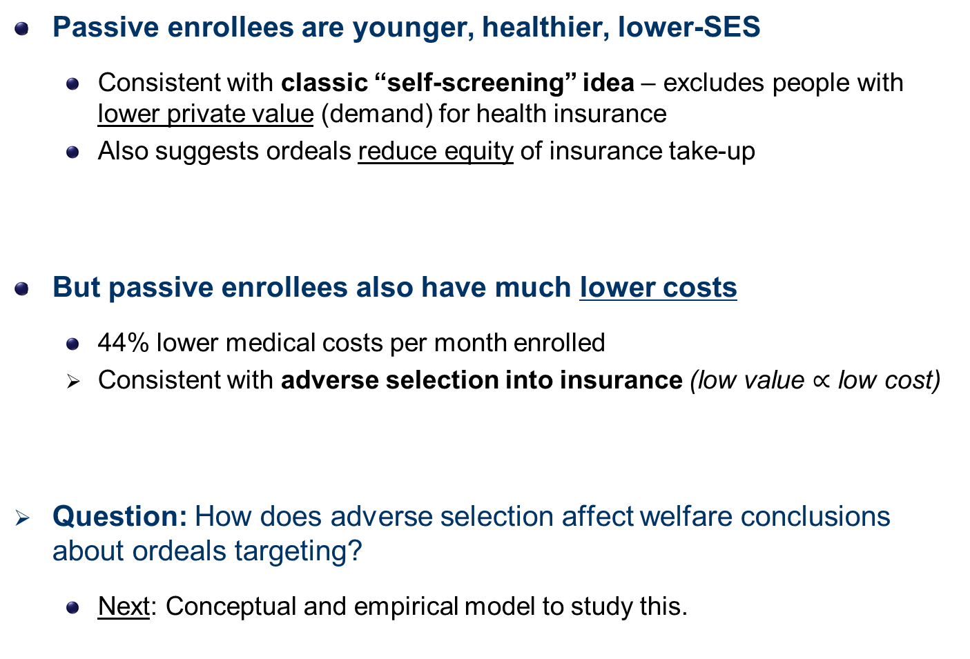
Summary of Targeting Findings
Passive enrollees are younger, healthier, lower-SES
  Consistent with classic “self-screening” idea – excludes people with lower private value (demand) for health insurance
  Also suggests ordeals reduce equity of insurance take-up
But passive enrollees also have much lower costs
  44% lower medical costs per month enrolled
  Consistent with adverse selection into insurance (low value $∝$ low cost)
Question: How does adverse selection affect welfare conclusions about ordeals targeting?
  Next: Conceptual and empirical model to study this.
Notes:
Improve this slide

Slide 40
Empirical Welfare Model

Slide 41
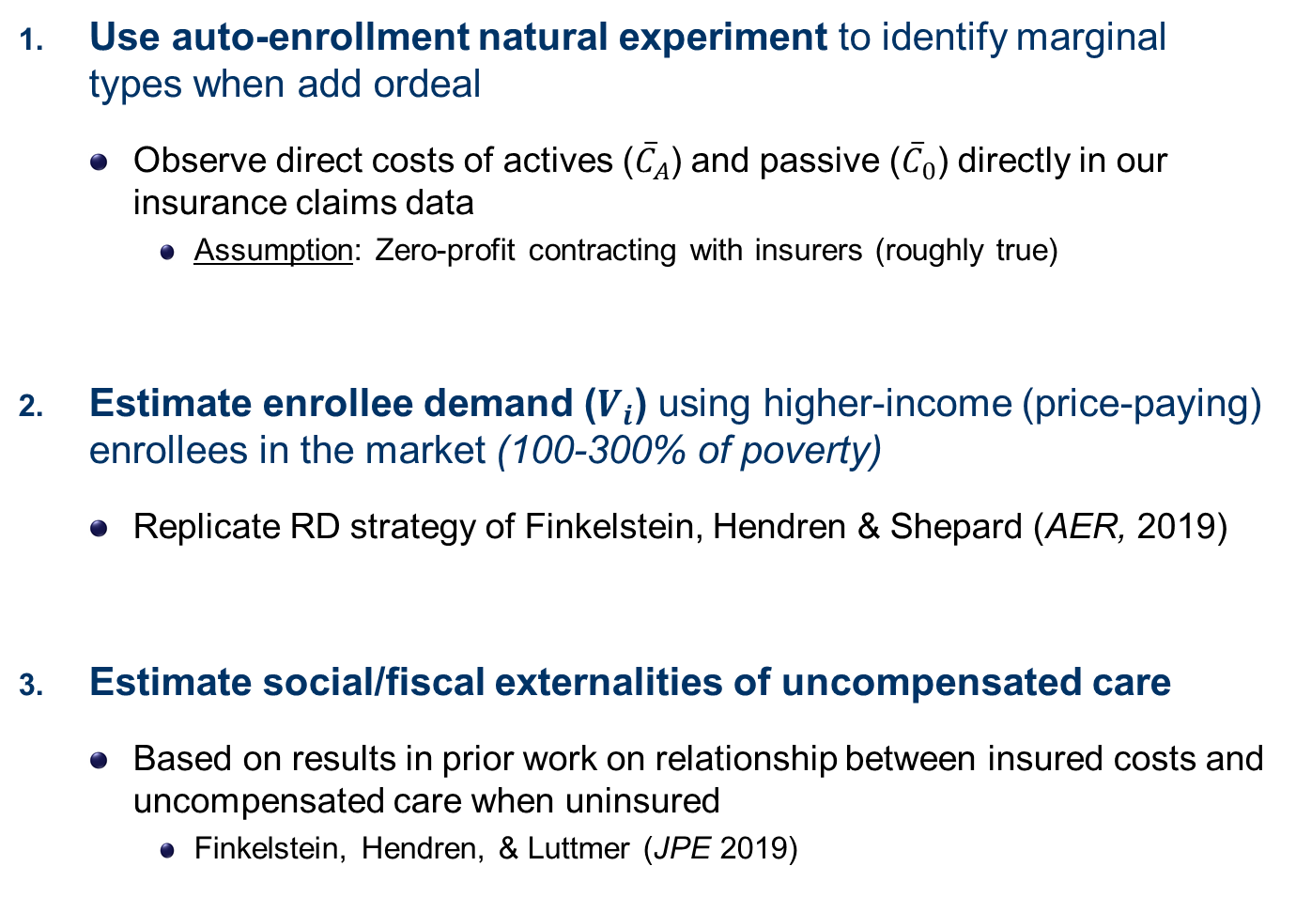
Estimating the Model
Use auto-enrollment natural experiment to identify marginal types when add ordeal
  Observe direct costs of actives (${\overline{C}}_{A}$) and passive (${\overline{C}}_{0}$) directly in our insurance claims data
    Assumption: Zero-profit contracting with insurers (roughly true)
Estimate enrollee demand ($V_{i}$) using higher-income (price-paying) enrollees in the market (100-300% of poverty)
  Replicate RD strategy of Finkelstein, Hendren & Shepard (AER, 2019)
Estimate social/fiscal externalities of uncompensated care
  Based on results in prior work on relationship between insured costs and uncompensated care when uninsured
    Finkelstein, Hendren, & Luttmer (JPE 2019)

Slide 42
Model Estimates: Selection on Value
.02
Passives
.015
y
t
i
s
n
.01
Actives
e
D
.005
0
0
100
200
300
400
Net Social Value ($/month)

Slide 43
Model Estimates: Value-Cost Correlation
800
)
n
600
o
m
/
$
(
t
s
o
C
400
l
a
i
c
o
S
Actives
t
e
N
200
Passives
0
100
200
300
400
500
Net Social Value ($/mon)

Slide 44
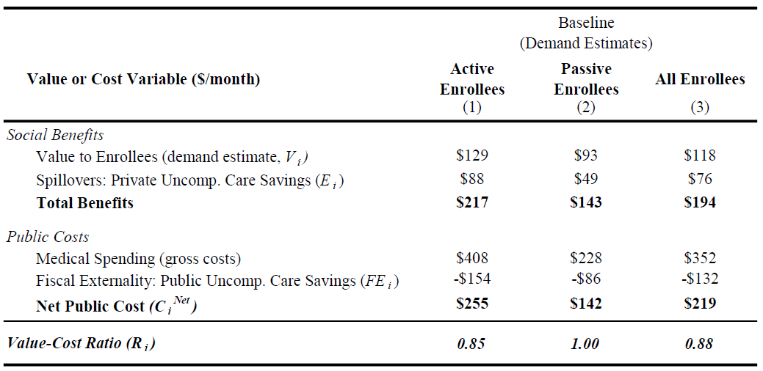
Targeting Impact of Auto-Enrollment
Summary: Passives are lower value (28-34%), but even more low-cost (44%)
  Estimate adverse selection “tax” = 109%
  Ordeal worsens targeting, even though correctly self-screen on value

Slide 45
Robustness Checks
Alternate estimates of demand (value):
  More unobserved sorting on value
  Median or 25th percentile (lowest) WTP
  Demand based on results from Finkelstein, Hendren, Luttmer (2019)
  Lower bound: Value = Estimated uninsured OOP costs
Alternate estimates of uncompensated care (externalities):
  Direct measure from Massachusetts APCD
  Bounds: Zero (LB) and 100% (UB) uncompensated care
Findings:
  Favorable “self-screening” on value robust to all alternatives
  Adverse selection reduces gains from value sorting by 60-350%

Slide 46
Conclusion

Slide 47
Conclusion
Ordeals have major impact on health insurance take-up
  33% reduction → very large relative to other policies like reminders/nudges
  Policy implication: Auto-enrollment may be a key step if want to get to universal coverage
Targeting: Enrolls young, healthy, low-cost, low-SES people
  Consistent with “self-screening” on low demand, but also low cost
  Suggests ordeals reduce equity of insurance take-up.
General take-away: Ordeals are unlikely to work well in “selection markets” like health insurance
  Highly relevant for social insurance programs.
  May also matter in many transfer programs (EITC, SNAP, welfare) where value and cost are correlated via benefit amounts.

Slide 48
Thank You!

Slide 49
Appendix Slides

Slide 50
Cost Effectiveness: Auto Enrollment vs. Subsidies
Auto
Subsidy Increase (
↓
premiums)
Public Cost Calculation
Enrollment
$39 to $0
$77 to $39
$116 to $77
($/month)
0-100% FPL
150% FPL
200% FPL
250% FPL
Spending on Marginal Enrollees
Medical Costs
$228
$196
$268
$281
Premiums Paid
$0
$0
$39
$77
Similar cost on marginals
Net Public Subsidy
$228
$196
$229
$204
Transfers to Inframarginals
Large subsidy transfer
(per newly enrolled)
---
$114
$106
$123
Total Cost per Newly Insured
Gross Govt. Cost
$228
$310
$336
$326
%
vs. auto-enr.
--
+36%
+47%
+43%
Δ
Net of Uncomp Care savings*
$82
$184
$164
$147
%
vs. auto-enr.
--
+125%
+100%
+79%
Δ
Subsidies 36-125% more expensive than auto enrollment
* Note: Estimates follow method in
Finkelstein, Hendren, Shepard (2019).

Slide 51
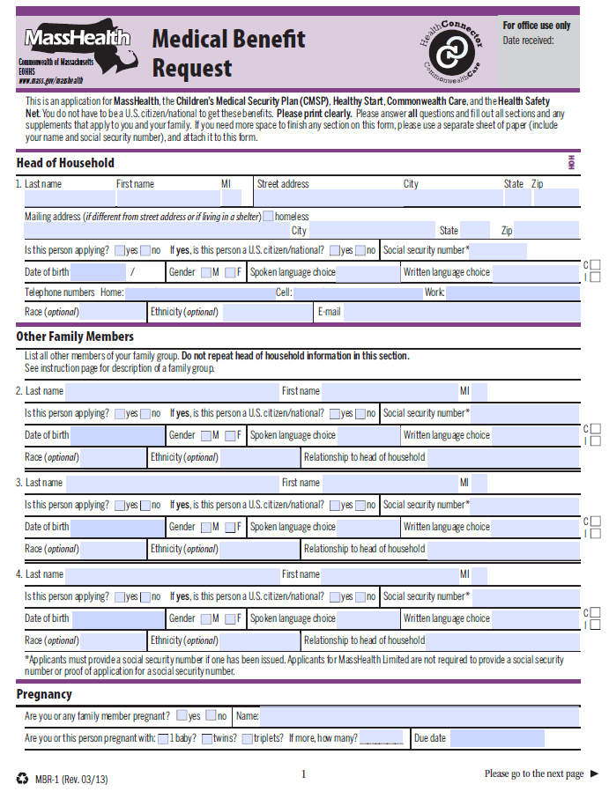
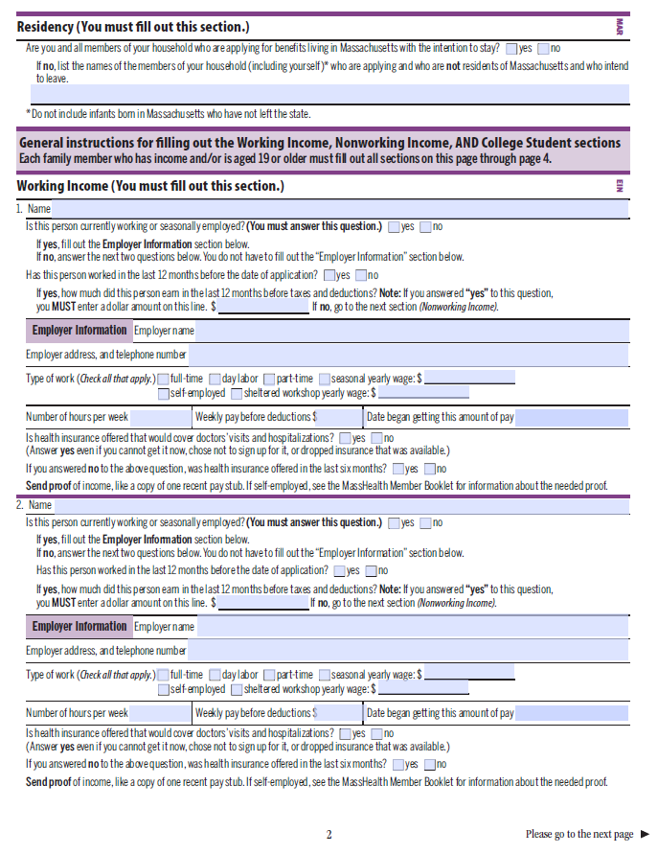
Step 1: Eligibility Application Form
← Go back

Slide 52
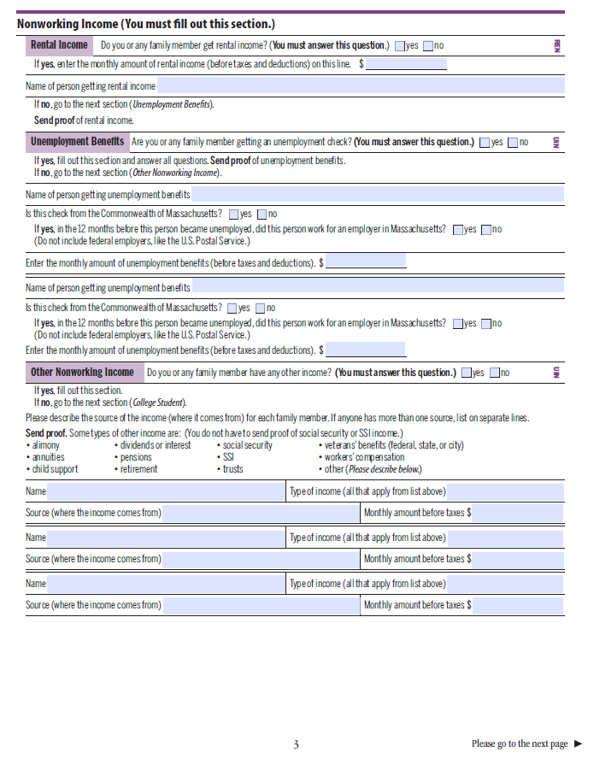
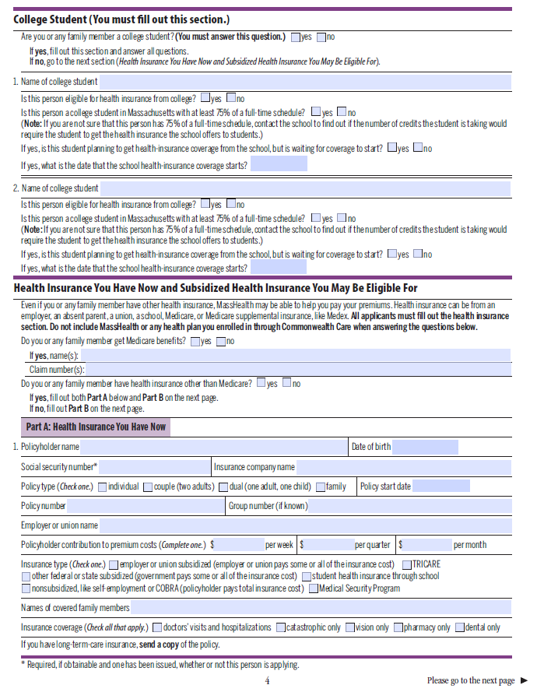
Step 1: Eligibility Application Form (2)
← Go back

Slide 53
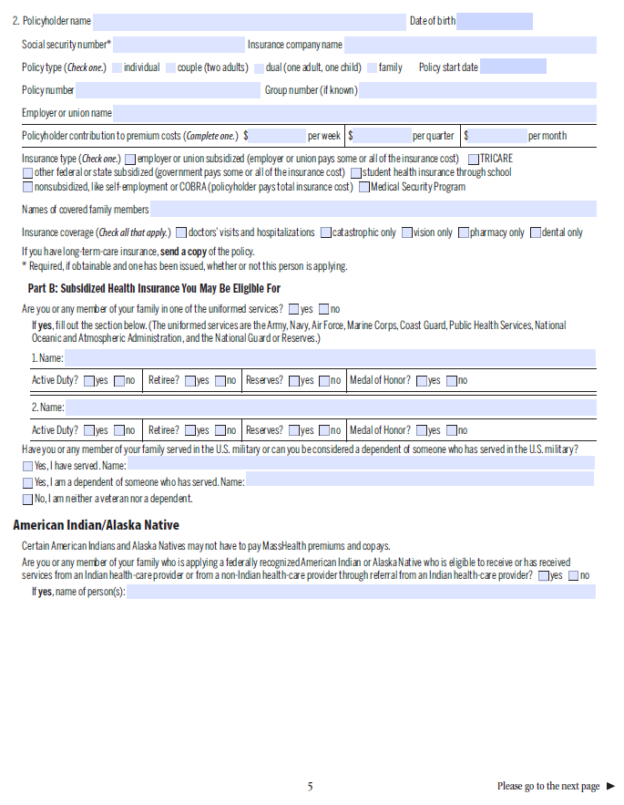
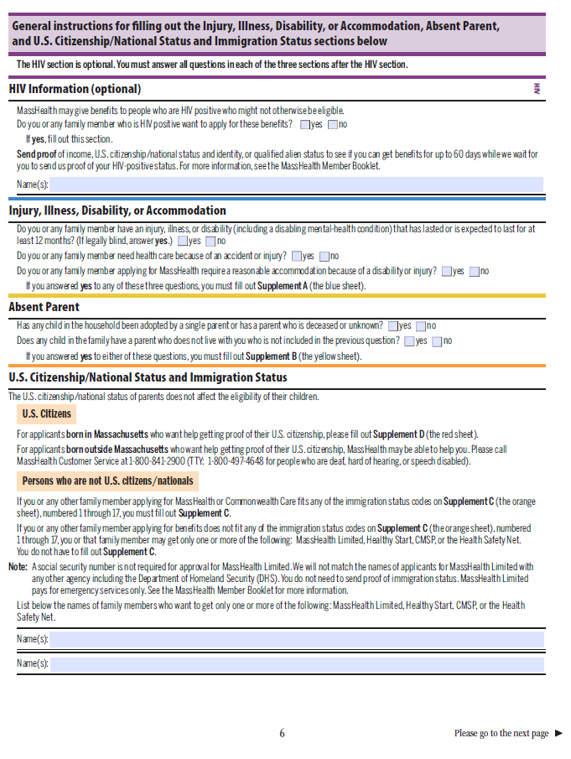
Step 1: Eligibility Application Form (3)
← Go back

Slide 54
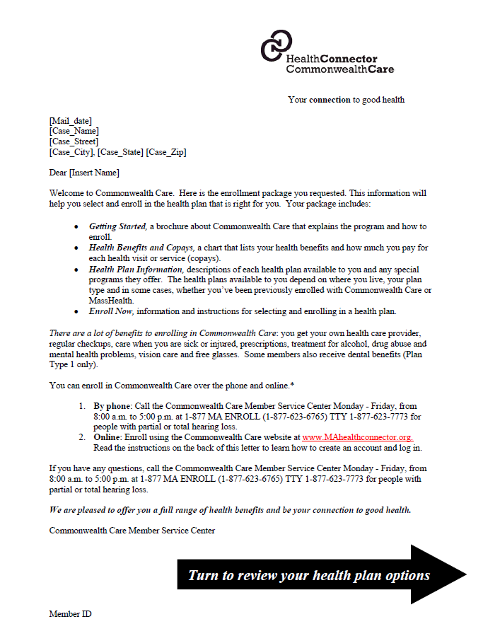
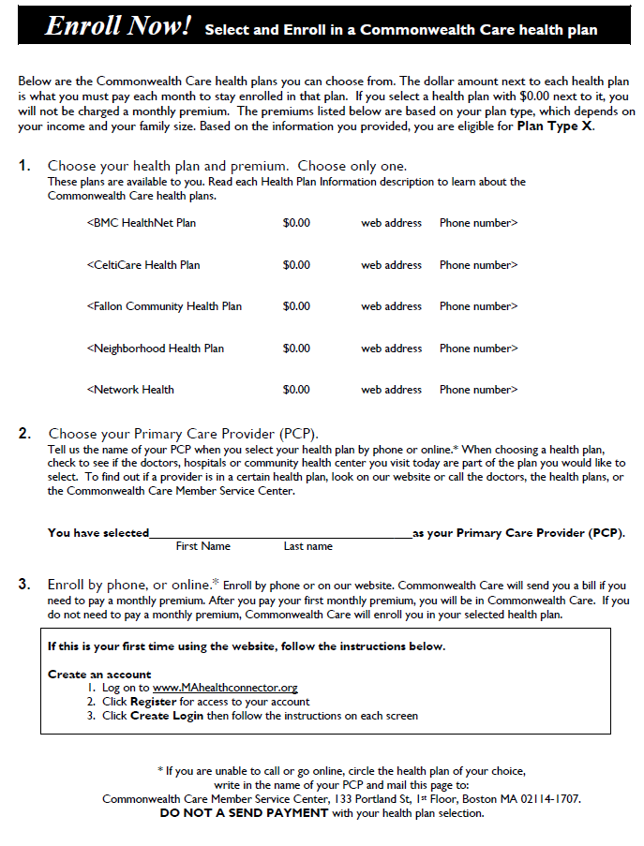
Step 2: Plan Choice Form
← Go back
Notes:
Note: This is form from post-2010 period when auto enrollment had ended (they couldn’t dig up a form from the old period).
In the pre-2010 form, it noted that auto assignment would happen: “If you do not choose a health plan by [ ], the Connector will choose one for you”

Slide 55
Context on Auto Enrollment Policy
This auto enrollment policy is standard in Medicaid managed care programs (called “auto assignment”)
Auto enrollment is very common in Medicaid
  Median state auto enrolls 45% of new enrollees (KFF 2015)
  But no previous evidence on causal effect of turning off this policy
    Other work uses random auto assignment to estimate causal plan effects [Garthwaite & Notowidigdo 2020; Geruso, Layton, Wallace 2020]
But not used by ACA health insurance exchanges
  Most people not eligible for $0 coverage, and states do not have legal authority to auto enroll and withhold premiums (e.g., via taxes).
  May help explain lower take-up of ACA exchanges.
← Go back
Notes:
Maybe move to appendix??

Slide 56
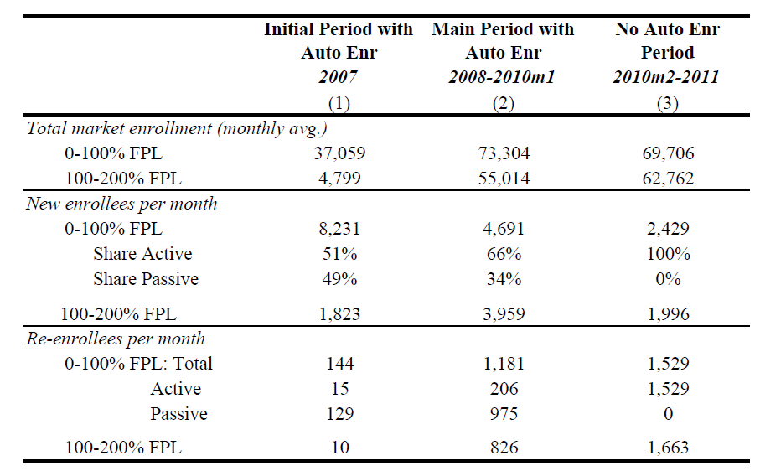
Summary Statistics
← Go back

Slide 57
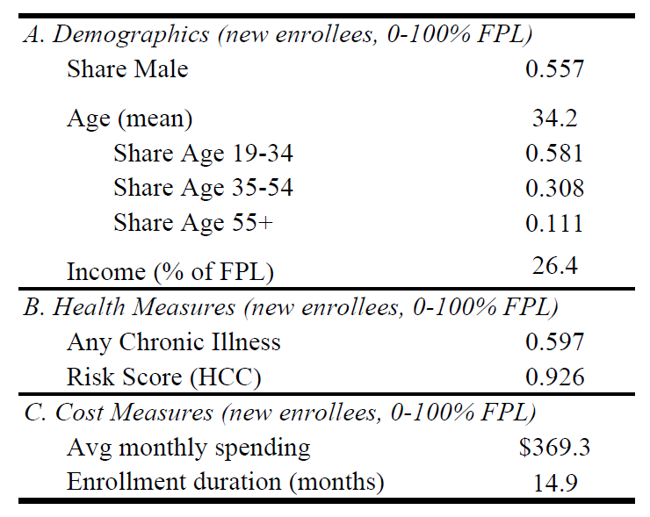
Summary Statistics (2)
← Go back

Slide 58
New Enrollees per Month (0-100% Poverty)
15,000
One-time auto enrollment
of charity care pool
Suspension of
auto enrollment
12,000
Passive Enrollees
= 43% of total
34% (in 2008-09)
9,000
Temporary
reinstatement
Total
6,000
3,000
Active
Choosers
0
2007
2008
2009
2010
2011
2012
Fiscal Year
← Go back
Notes:
First look at the data. Note three things: (1) explain axes and series, (2) one-time auto enrollment of charity care pool – we will focus on 2008-09 steady state, (3) fall at 2010 then jump with reinstatement – exactly what you’d predict

Slide 59
New Enrollees per Month into Exchange
16000
Suspension of
auto-enrollment
12000
Passive Enrollees
= 43% of total
34% (in 2008-09)
Temporary
reinstatement
8000
Total
4000
Active
Choosers
0
2007
2008
2009
2010
2011
2012
Fiscal Year
← Go back
Notes:
Ungrouped and Formatted: newEnr_cnts_monthly.emf

Slide 60
Evidence: No Change in Average Attributes
Share Male for New Enrollees
Passive Enrollees
Temporary
reinstatement
Active Choosers
No jump up in share male
← Go back
Notes:
Might be concerned that raw counts is noisy, misses something going on
Now, look at whether attributes converge – if passives are becoming active at the policy change, should see the characteristics of active choosers converge towards passive group
We see no evidence of this (here for share male)

Slide 61
Evidence: No Change in Average Attributes
Average Age of New Enrollees
No jump down in average age
Active Choosers
Passive Enrollees
Temporary
reinstatement
← Go back

Slide 62
Evidence: No Change in Average Attributes
Average Spell Length of New Enrollees
Active Choosers
No jump down in avg. spell length
Passive Enrollees
Temporary
reinstatement
← Go back
Notes:
To update

Slide 63
Effect on Steady State Enrollment
Total Enrollment (0-100% poverty)
80,000
Steady State Calculation
61.4k
60,000
Increase = +14.89k (+32%)
Joined Actively
46.5k
40,000
Joined Passively
≈ 24% of eligible uninsured 0-100% of poverty (ACS)
20,000
14.9k
0
2008
2009
2010
2011
2012
2013
2014
Fiscal Year
← Go back
Notes:
Skip if low on time
Math on calculations -- ACS: 62,000 CC-eligible uninsured in FPL group 0-100% in 2009. Range is 60k-65k over 2008-2013. 14890/62000 = 24%

Slide 64
APCD Analysis: Low Rates of Coverage Duplication
Share of CommCare Enrollment Months with Duplicate Private Insurance
.06
.05
.04
Temporary Reinstatement
.03
Suspension of auto enrollment
.02
.01
0
2009
2010
2011
2012
← Go back
Date of Entering CommCare

Slide 65
Robustness: Inferring Targeting from Policy Change
Average Medical Risk Score of New Enrollees
1.25
<100% FPL (treatment)
1
100-200% FPL (control)
Suspension of auto enrollment
DD = 0.146 **
.75
(0.019)
Implication: Marginal enrollees have 0.45 lower medical risk scores than inframarginal enrollees.
.5
2009
2010
2011
2012
Fiscal Year
← Go back

Slide 66
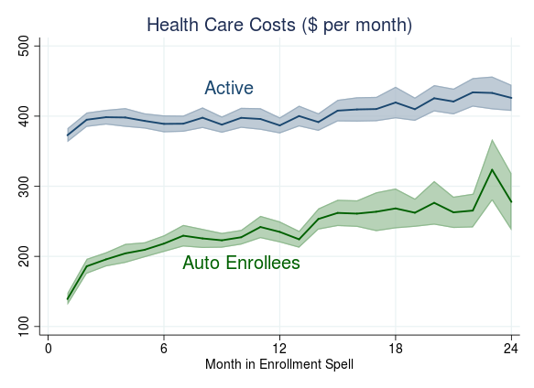
Timing of Cost Differences
~33% lower
(months 12-24)
60% lower
(first month)
Note: Plots show estimates from regression with individual fixed effects to control for attrition.
Notes:
REDO THESE AND SWITCH COLORS TO MATCH, also change to “Passive” not auto
Low initial costs might suggest an awareness story

Slide 67
Differential Use of Charity Care Sources
Physician/ER Visits per month
Share of Costs and Hospitals Used
ratio = 0.51
ratio = 0.90
Share of Costs:
Hospital Emergency Care
Hospital Use:
Share at Safety Net Hospitals
Notes:
Physician office = PCP

Slide 68
Signs of Real Benefits from Insurance
Do passive enrollees benefit from having health insurance?
Metric #1: Risk Protection
  Passives are less likely than actives to experience medical shocks
  But the difference is one of degree – they do face real risks
    60% as likely to have a high-cost month (>$500, >$1k, or >$2k)
    75% as likely to have an emergency hospitalization (→ Graphs)
Metric #2: Coverage of Predictable Expenses
  About ¼ of passives regularly use a chronic med (vs. ½ of active)
    Mean cost = $45 per month (→ $450 over 10-month spell)
    Unlikely to be covered by charity care
Summary: Signs of meaningful benefits from having insurance (despite failure to actively take up)

Slide 69
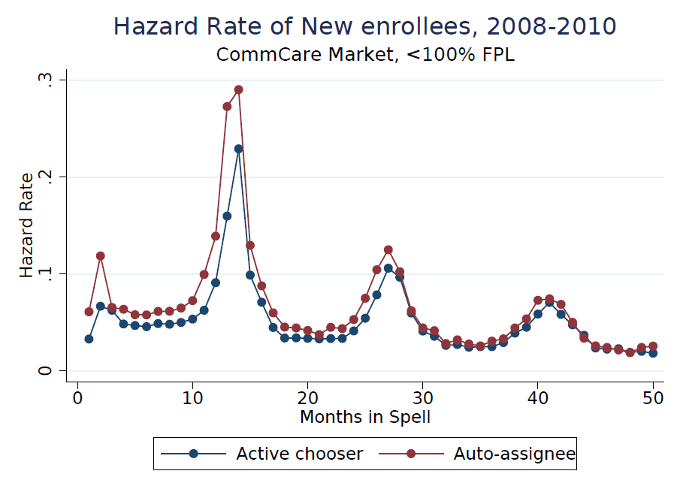
← Go back

Slide 70
Probability of Medical Shocks
1
ratio = 0.76
90%
Key point: Passives are lower-risk, but still
reasonably likely to have a medical need
8
.
68%
ratio = 0.62
6
58%
.
ratio = 0.58
4
.
36%
36%
ratio = 0.58
2
21%
19%
.
11%
ratio = 0.75
3.6%
2.7%
0
Cost >$0
Cost >$500
Cost >$1k
Cost >$2k
IP Emergency
Share with High-Cost Month/Event (first year enrolled)
← Go back
Active
Passive
Notes:
Change stata graph so notation matches here.
Also if possible rotate the y-axes labels to be upright.

Slide 71
No Evidence of Choice Overload
No relationship between choice set size and passive enrollment rate, either cross-sectionally or using plan entry/exit (DD)
Panel A: Cross-Area Relationship
Panel B: Diff-in-Diff
# of Plans
Passive
Sample Size
Available
Rate
(new enrollees)
Outcome: Passive Rate
1
33.9%
6,696
#Plans*Post
-0.014
2
34.5%
5,009
(0.011)
3
35.2%
50,886
Num Obs.
4
32.9%
46,103
(area-months)
874
Avg
34.1%
108,694
← Go back

